Slide 1
Database Components & Architecture
By Dr. Ejaz Ahmed

Slide 2
Objectives
DBMS Components
Database Operational Architectures
Database with LAN & Internet Framework
Dr. Ejaz Ahmed

Slide 3
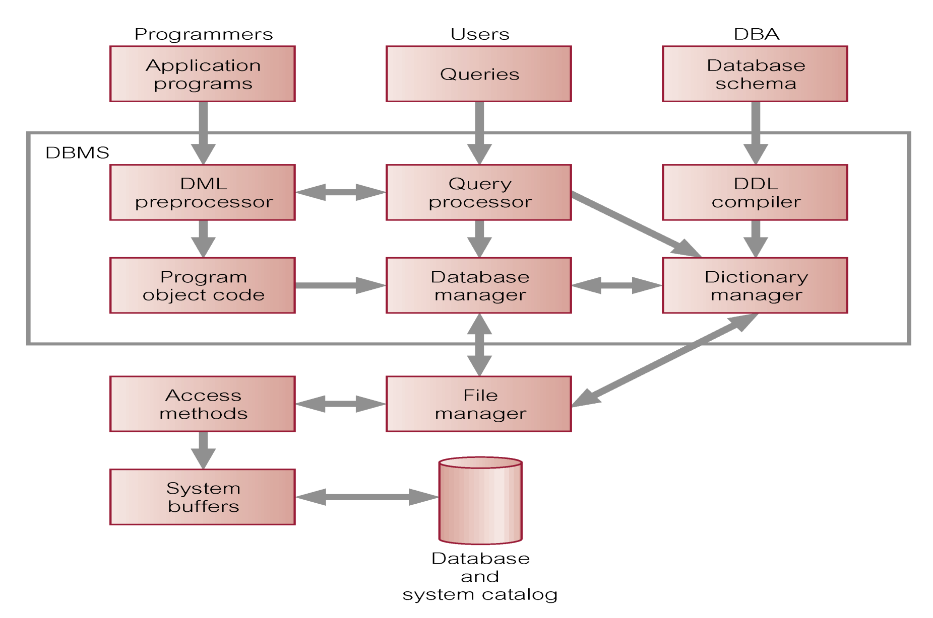
DBMS Components & their Interactions

Slide 4
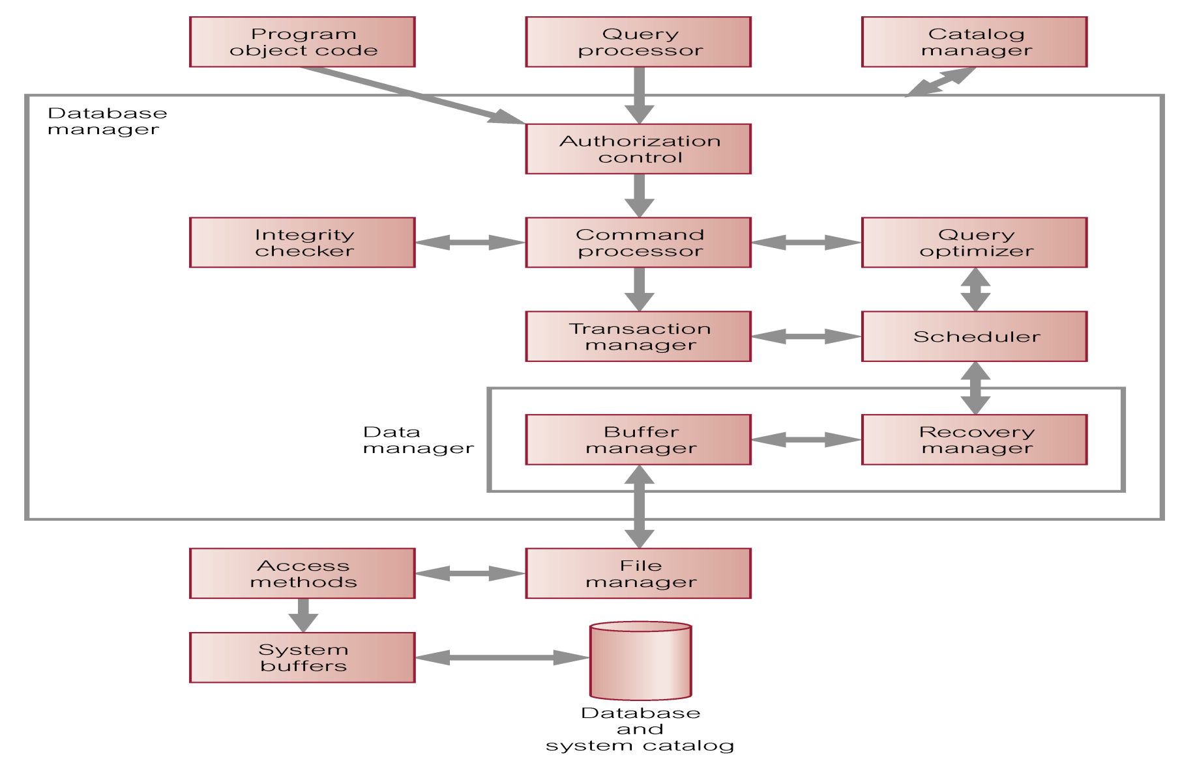
Components of Database Manager (DM)

Slide 5
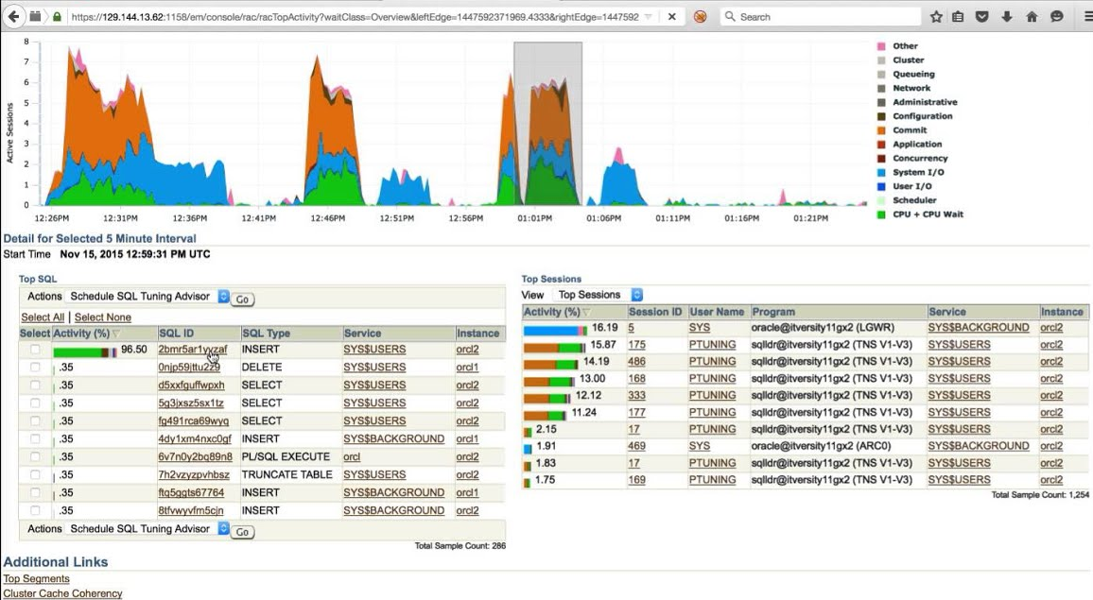
Oracle Enterprise Manager (EM)
Dr. Ejaz Ahmed
Notes:
A Technological Example of Database Manager

Slide 6
Multi-User DBMS Architectures
Teleprocessing
File-Server
Client-Server (2-tiers, 3 tiers)
Dr. Ejaz Ahmed

Slide 7
Teleprocessing
Traditional architecture
Single mainframe with a number of terminals attached
Trend is now towards downsizing
Dr. Ejaz Ahmed

Slide 8
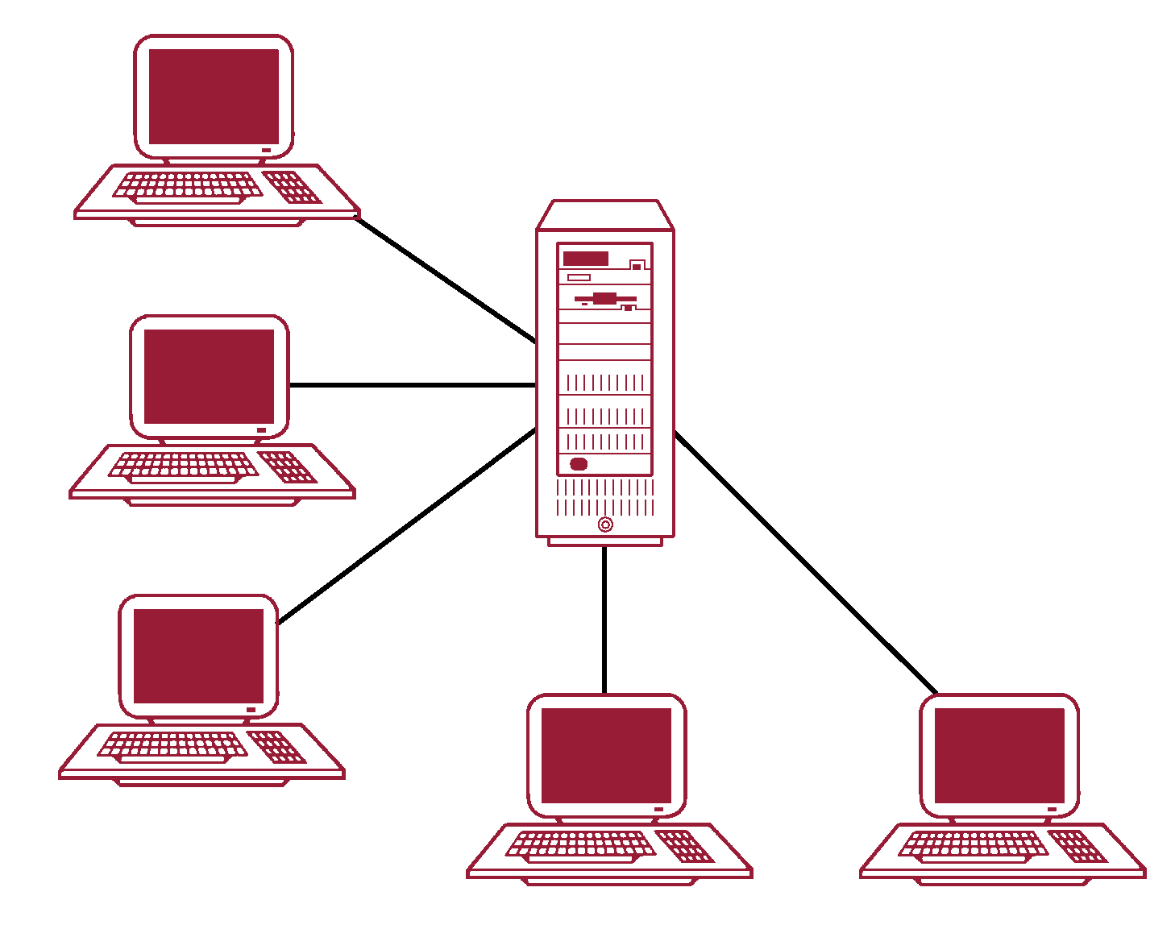
Teleprocessing Topology
Dr. Ejaz Ahmed

Slide 9
File Server
File-Server is connected to several workstations across a network
Database resides on file-server
DBMS and applications run on each workstation
Disadvantages includes:
  Significant network traffic
  Copy of DBMS on each workstation
  Concurrency, recovery and integrity control more complex
Dr. Ejaz Ahmed

Slide 10
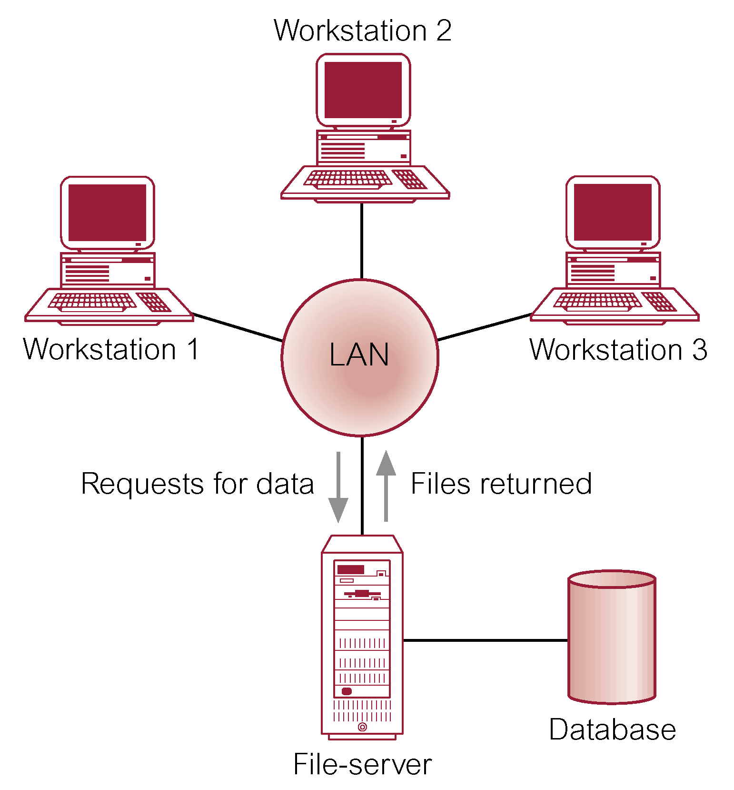
File Server Architecture
Dr. Ejaz Ahmed

Slide 11
Client-Server
Server holds the database and the DBMS
Client manages user interface and runs applications
Advantages include:
  Wider access to existing database
  Increased performance
  Reduction in communication costs
  Increased consistancy
Dr. Ejaz Ahmed

Slide 12
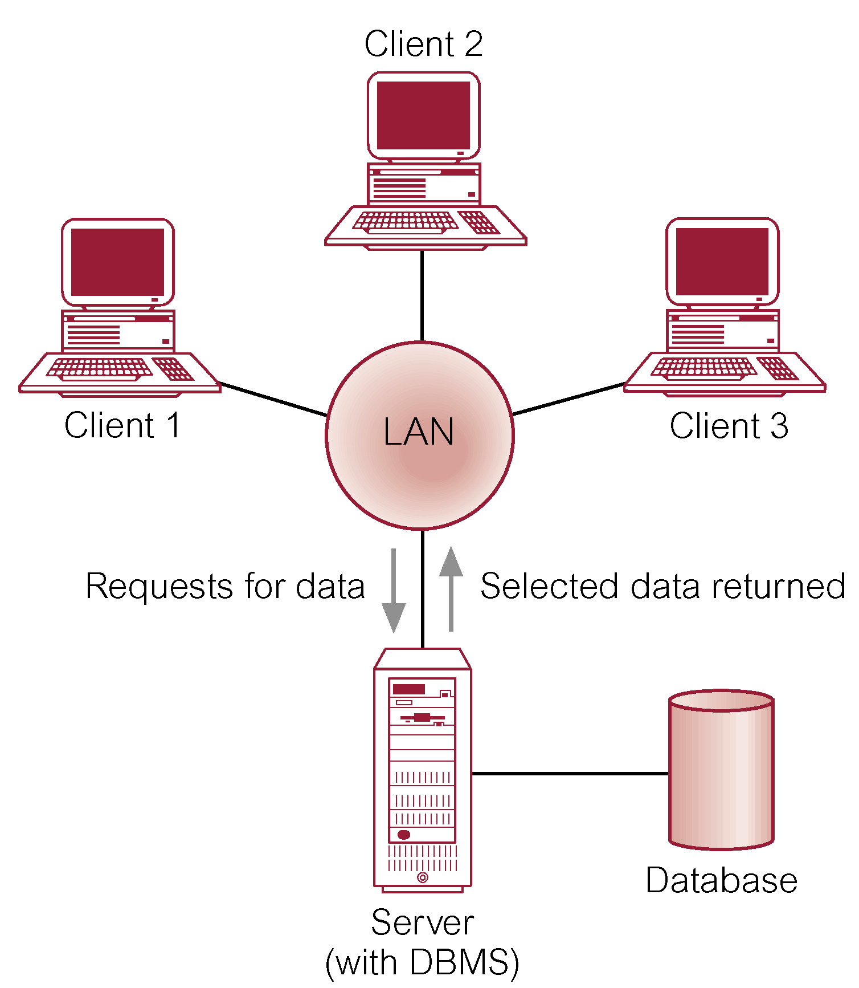
Client-Server Architecture (2-tiers)
DB Connections can be managed by ODBC, JDBC
Notes:
Data access can be possible using LAN inside the premises of an Enterprise
What is Computer Networking?
What is LAN?
What is Client and Server?
Example: https://www.sap.com/mena/index.html
How does the SAP ERP system work?
As an on-premises ERP system, SAP ECC is usually deployed in a three-tier, client-server architecture. The three tiers are the presentation tier, the application tier and the database tier.
The presentation tier provides the user with the SAP graphical user interface (SAP GUI), which can be installed on any computer that uses Microsoft Windows or macOS. The SAP GUI is the point of communication between the user and ECC.
The application tier is the core of ECC. It is responsible for processing transactions, executing business logic, running reports, monitoring access to the database, printing documents and communicating with other applications.
The database tier is where the records of transactions and other data are stored.

Slide 13
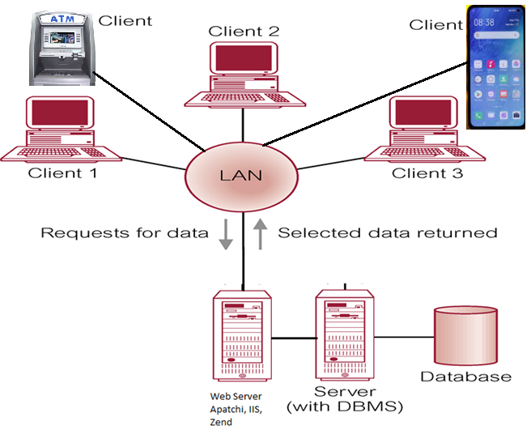
Client-Server Architecture (3-tiers)
DB Connections can be managed by using MS ODBC, JDBC
Notes:
Data access can be possible from LAN to internet users
Enterprise is HBL: Clients are your pc, laptop, Mobile and ATM, accessing data from central server located in KHI (web/ internet is being used)
Another example:
Account holder is reading balance amount on pc in Islamabad using internet from Bank’s DB Server Machine through web server in Karachi

Slide 14
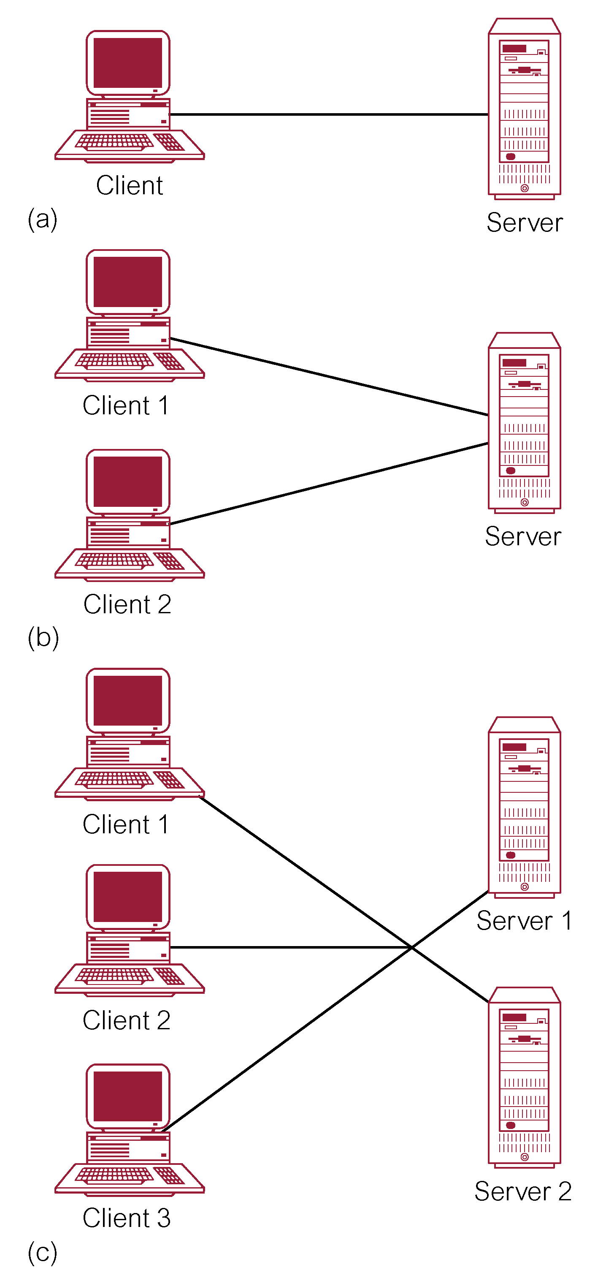
Alternative Client-Server Topologies
Dr. Ejaz Ahmed

Slide 15
Paradigms of Database Systems
Logical/ Conceptual Database Design
  How should the transactional data be modeled (OLTP)?
  Designing the data warehouse schema (OLAP)
Query Processing
  Analysis queries are hard to answer efficiently
  What techniques are available to the DBMS?
Physical Database Design
  How should the data be organized on disk?
  What data structures should be used?
Data Mining
  What use is all this data?
  Which questions should we ask our data warehouse OLAP?
Data Science/Big Data/ Data Analytics
Dr. Ejaz Ahmed

Slide 16
END
Dr. Ejaz Ahmed

